Slide 1

Murders in the Rue Morgue
By: Brainstormers
Notes:
Introduction: Ibrahim

Slide 2
Data
Whist has long been noted for its influence upon what is termed the calculating power; and men of the highest order of intellect have been known to take an apparently unaccountable delight in it, while eschewing chess as frivolous. Beyond doubt there is nothing of a similar nature so greatly tasking the faculty of analysis.
These are not only manifold but multiform, and lie frequently among recesses of thought altogether inaccessible to the ordinary understanding. To observe attentively is to remember distinctly; and, so far, the concentrative chess-player will do very well at whist; while the rules of Hoyle (themselves based upon the mere mechanism of the game) are sufficiently and generally comprehensible.
The first two or three rounds having been played, he is in full possession of the contents of each hand, and thenceforward puts down his cards with as absolute a precision of purpose as if the rest of the party had turned outward the faces of their own. At such times I could not help remarking and admiring (although from his rich ideality I had been prepared to expect it) a peculiar analytic ability in Dupin. He seemed, too, to take an eager delight in its exercise --- if not exactly in its display --- and did not hesitate to confess the pleasure thus derived.

Slide 3
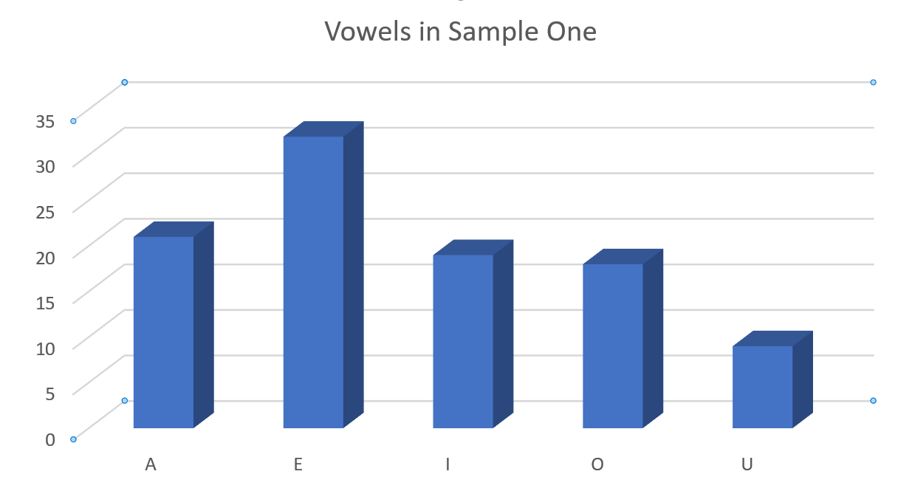

Slide 4
Statistics
Sample1
E: 32 times - E is the most occurring vowel. On average, E shows up 19.8 times out of the other vowels
I: 19 times
A : 21 times
O-18 times
U: 9 times
Sample2
Sample3
Notes:
Question: Estimate the mean frequently occurring vowel.
Anwer: Since E is the most frequent vowel out of all three samples, the mean would be 45.
32 + 50 + 54 = 136
136/3 = 45

Slide 5
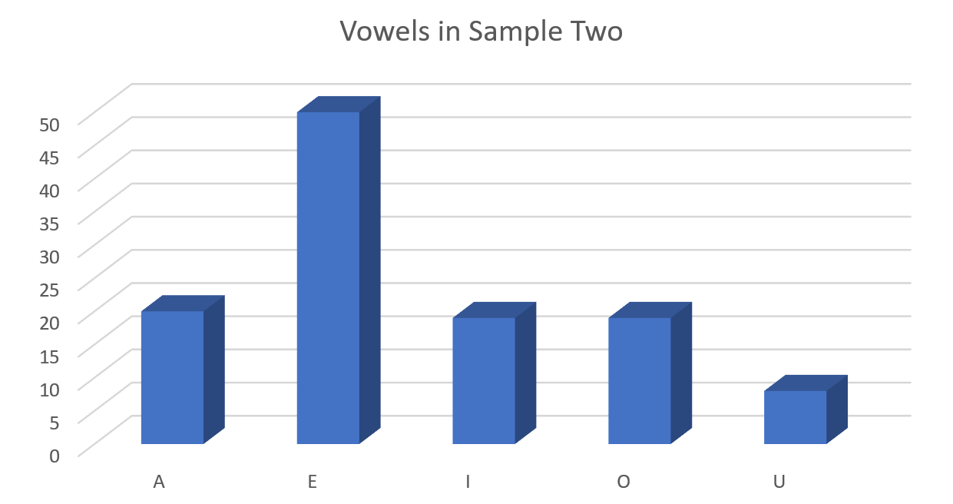

Slide 6
Statistics
Sample1
E: 32 times - E is the most occurring vowel. On average, E shows up 19.8 times out of the other vowels
I: 19 times
A : 21 times
O-18 times
U: 9 times
Sample2
E: 50 times. - E is the most occurring vowel. On average, E shows up 23.2 times out of the other vowels
I: 19 times
A: 20 times
O-19 times
U: 8 times
Sample3
Notes:
Question: Estimate the mean frequently occurring vowel.
Anwer: Since E is the most frequent vowel out of all three samples, the mean would be 45.
32 + 50 + 54 = 136
136/3 = 45

Slide 7
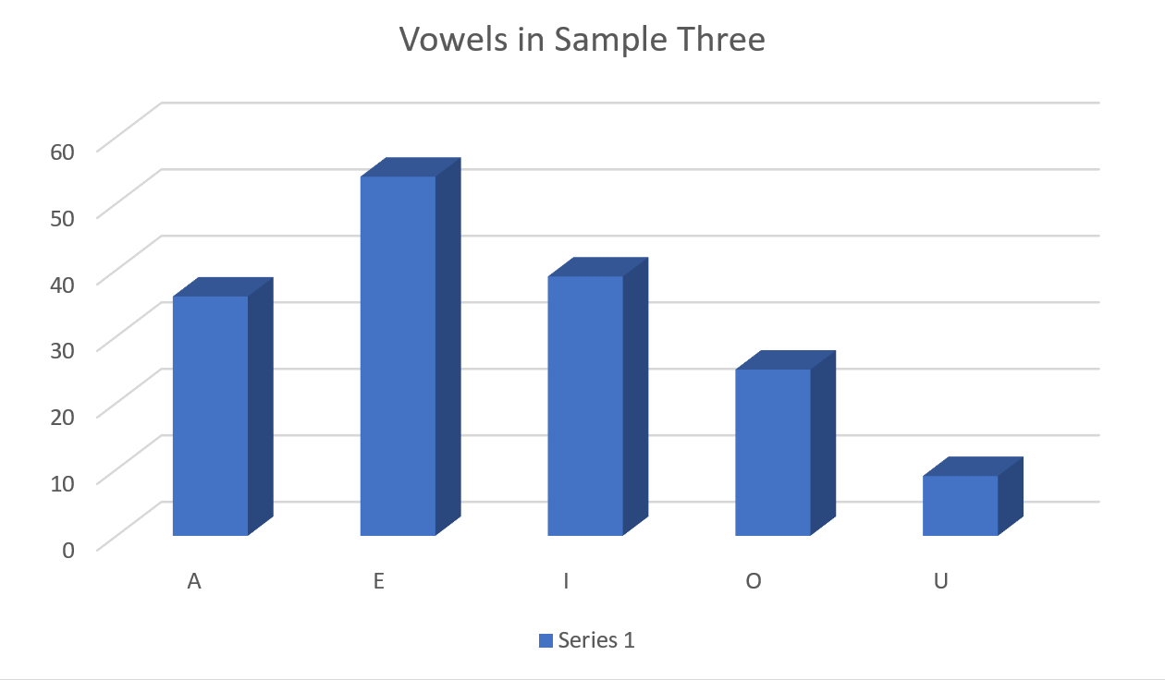

Slide 8
Statistics
Sample1
E: 32 times - E is the most occurring vowel. On average, E shows up 19.8 times out of the other vowels
I: 19 times
A : 21 times
O-18 times
U: 9 times
Sample2
E: 50 times. - E is the most occurring vowel. On average, E shows up 23.2 times out of the other vowels
I: 19 times
A: 20 times
O-19 times
U: 8 times
Sample3
E: 54 times - E is the most occurring vowel. On average, E shows up 33.6 times out of the other vowels
I: 39 times
A: 36 times
O-25 times
U: 14 times
*Most frequent vowel = Mean of e per sample = 45
Notes:
Question: Estimate the mean frequently occurring vowel.
Anwer: Since E is the most frequent vowel out of all three samples, the mean would be 45.
32 + 50 + 54 = 136
136/3 = 45

Slide 9
Thank You

